Slide 1
Order Statistics
David Kauchak
cs140
Spring 2024

Slide 2
Administrative
Group session timing (see slack post)

Slide 3
Medians
The median of a set of numbers is the number such that half of the numbers are larger and half smaller
How might we calculate the median of a set?
Sort the numbers, then pick the n/2 element
A = [50, 12, 1, 97, 30]
A = [1, 12, 30, 50, 97]
runtime?

Slide 4
Medians
The median of a set of numbers is the number such that half of the numbers are larger and half smaller
How might we calculate the median of a set?
Sort the numbers, then pick the n/2 element
A = [50, 12, 1, 97, 30]
A = [1, 12, 30, 50, 97]
Θ(n log n)

Slide 5
Selection
More general problem: find the k-th smallest element in an array
i.e., element where exactly k-1 things are smaller than it
Aka, the “selection” problem
Can use this to find the median if we want.
Can we solve this in a similar way?
Yes, sort the data and take the k-th element
Θ(n log n)

Slide 6
Can we do better?
Are we doing more work than we need to?
To get the k-th element (or the median) by sorting, we’re finding all the k-th elements at once
We just want the one!
Often when you find yourself doing more work than you need to, there is a faster way (though not always).

Slide 7

selection problem
Our tools
divide and conquer
sorting algorithms
other functions
merge
partition
binary search

Slide 8
Partition
Partition takes Θ(n) time and performs a similar operation
given an element A[q], Partition can be seen as dividing the array into three sets:
< A[q]
= A[q]
> A[q]
Ideas?

Slide 9
An example
We’re looking for the 5th smallest
5 2 34 9 17 2 1 34 18 5 3 2 1 6 5
If we called partition, what would be the in three sets?
< 5:
= 5:
> 5:

Slide 10
An example
We’re looking for the 5th smallest
5 2 34 9 17 2 1 34 18 5 3 2 1 6 5
< 5: 2 2 1 3 2 1
Does this help us?
= 5: 5 5 5
> 5: 34 9 17 34 18 6

Slide 11
An example
We’re looking for the 5th smallest
5 2 34 9 17 2 1 34 18 5 3 2 1 6 5
We know the 5th smallest must be in this set
< 5: 2 2 1 3 2 1
= 5: 5 5 5
> 5: 34 9 17 34 18 6

Slide 12
Selection(A, k, p, r)
q ← Partition(A,p,r) relq = q-p+1 if k = relq Return A[q] else if k < relq Return Selection(A, k, p, q-1) else // k > relq Return Selection(A, k-relq, q+1, r)
A: array of data
k: find the kth smallest
p,r: current span we’re exploring (initially 1, len(A))

Slide 13
Selection: divide and conquer
Call Partition
Decide which of the three sets contains the answer we’re looking for.
Recurse.
Like binary search on unsorted data
Selection(A, k, p, r)
q ← Partition(A,p,r) relq = q-p+1 if k = relq Return A[q] else if k < relq Return Selection(A, k, p, q-1) else // k > relq Return Selection(A, k-relq, q+1, r)
?

Slide 14
relq
Partition returns the absolute index, but we want an index relative to the current p (window start)
relq = q – p + 1
q
p
r

Slide 15
relq
Partition returns the absolute index, but we want an index relative to the current p (window start)
relq = q – p + 1
q
p
r
q – p + 1

Slide 16
relq
Partition returns the absolute index, we want an index relative to the current p (window start)
relq = q – p + 1
q=7
p=5
r=9
What is relq?

Slide 17
relq
Partition returns the absolute index, we want an index relative to the current p (window start)
relq = q – p + 1
q=7
p=5
r=9
7-5+1=3

Slide 18
Selection: divide and conquer
Call partition
decide which of the three sets contains the answer we’re looking for
recurse
Like binary search on unsorted data
Selection(A, k, p, r)
q ← Partition(A,p,r) relq = q-p+1 if k = relq Return A[q] else if k < relq Return Selection(A, k, p, q-1) else // k > relq Return Selection(A, k-relq, q+1, r)
Partition returns the absolute index, we want an index relative to the current p (window start)

Slide 19
Selection: divide and conquer
Call partition
decide which of the three sets contains the answer we’re looking for
recurse
Like binary search on unsorted data
Selection(A, k, p, r)
q ← Partition(A,p,r) relq = q-p+1 if k = relq Return A[q] else if k < relq Return Selection(A, k, p, q-1) else // k > relq Return Selection(A, k-relq, q+1, r)
As we recurse, we may update the k that we’re looking for because we update the lower end

Slide 20
Selection(A, 3, 1, 8)
1 2 3 4 5 6 7 8
5 7 1 4 8 3 2 6
Selection(A, k, p, r)
q ← Partition(A,p,r) relq = q-p+1 if k = relq Return A[q] else if k < relq Selection(A, k, p, q-1) else // k > relq Selection(A, k-relq, q+1, r)

Slide 21
Selection(A, 3, 1, 8)
1 2 3 4 5 6 7 8
5 1 4 3 2 6 8 7
relq = 6 – 1 + 1 = 6
Selection(A, k, p, r)
q ← Partition(A,p,r) relq = q-p+1 if k = relq Return A[q] else if k < relq Selection(A, k, p, q-1) else // k > relq Selection(A, k-relq, q+1, r)

Slide 22
Selection(A, 3, 1, 8)
1 2 3 4 5 6 7 8
5 1 4 3 2 6 8 7
relq = 6 – 1 + 1 = 6
Selection(A, k, p, r)
q ← Partition(A,p,r) relq = q-p+1 if k = relq Return A[q] else if k < relq Selection(A, k, p, q-1) else // k > relq Selection(A, k-relq, q+1, r)

Slide 23
Selection(A, 3, 1, 5)
1 2 3 4 5 6 7 8
5 1 4 3 2 6 8 7
At each call, discard part of the array
Selection(A, k, p, r)
q ← Partition(A,p,r) relq = q-p+1 if k = relq Return A[q] else if k < relq Selection(A, k, p, q-1) else // k > relq Selection(A, k-relq, q+1, r)

Slide 24
Selection(A, 3, 1, 5)
1 2 3 4 5 6 7 8
1 2 4 3 5 6 8 7
relq = 2 – 1 + 1 = 2
Selection(A, k, p, r)
q ← Partition(A,p,r) relq = q-p+1 if k = relq Return A[q] else if k < relq Selection(A, k, p, q-1) else // k > relq Selection(A, k-relq, q+1, r)

Slide 25
Selection(A, 1, 3, 5)
1 2 3 4 5 6 7 8
1 2 4 3 5 6 8 7
Selection(A, k, p, r)
q ← Partition(A,p,r) relq = q-p+1 if k = relq Return A[q] else if k < relq Selection(A, k, p, q-1) else // k > relq Selection(A, k-relq, q+1, r)

Slide 26
Selection(A, 1, 3, 5)
1 2 3 4 5 6 7 8
1 2 4 3 5 6 8 7
Selection(A, k, p, r)
q ← Partition(A,p,r) relq = q-p+1 if k = relq Return A[q] else if k < relq Selection(A, k, p, q-1) else // k > relq Selection(A, k-relq, q+1, r)

Slide 27
Selection(A, 1, 3, 5)
1 2 3 4 5 6 7 8
1 2 4 3 5 6 8 7
relq = 5 – 3 + 1 = 3
Selection(A, k, p, r)
q ← Partition(A,p,r) relq = q-p+1 if k = relq Return A[q] else if k < relq Selection(A, k, p, q-1) else // k > relq Selection(A, k-relq, q+1, r)

Slide 28
Selection(A, 1, 3, 4)
1 2 3 4 5 6 7 8
1 2 4 3 5 6 8 7
Selection(A, k, p, r)
q ← Partition(A,p,r) relq = q-p+1 if k = relq Return A[q] else if k < relq Selection(A, k, p, q-1) else // k > relq Selection(A, k-relq, q+1, r)

Slide 29
Selection(A, 1, 3, 4)
1 2 3 4 5 6 7 8
1 2 4 3 5 6 8 7
Selection(A, k, p, r)
q ← Partition(A,p,r) relq = q-p+1 if k = relq Return A[q] else if k < relq Selection(A, k, p, q-1) else // k > relq Selection(A, k-relq, q+1, r)

Slide 30
Selection(A, 1, 3, 4)
1 2 3 4 5 6 7 8
1 2 3 4 5 6 8 7
Selection(A, k, p, r)
q ← Partition(A,p,r) relq = q-p+1 if k = relq Return A[q] else if k < relq Selection(A, k, p, q-1) else // k > relq Selection(A, k-relq, q+1, r)

Slide 31
Selection(A, 1, 3, 4)
1 2 3 4 5 6 7 8
1 2 3 4 5 6 8 7
relq = 3 – 3 + 1 = 1
Selection(A, k, p, r)
q ← Partition(A,p,r) relq = q-p+1 if k = relq Return A[q] else if k < relq Selection(A, k, p, q-1) else // k > relq Selection(A, k-relq, q+1, r)

Slide 32
Running time of Selection?
Best case?
We get lucky and the element at the end of the list is the kth smallest element!
One call to partition: θ(n)

Slide 33
Running time of Selection?
Worst case?
Each call to Partition only reduces our search by 1
Recurrence?
θ(n²)

Slide 34
Running time of Selection?
Worst case?
Each call to Partition only reduces our search by 1
When does this happen?
sorted
reverse sorted
others…

Slide 35
How can randomness help us?
RSelection(A, k, p, r)
q ← RPartition(A,p,r) if k = q Return A[q] else if k < q Return Selection(A, k, p, q-1) else // k > q Return Selection(A, k, q+1, r)

Slide 36
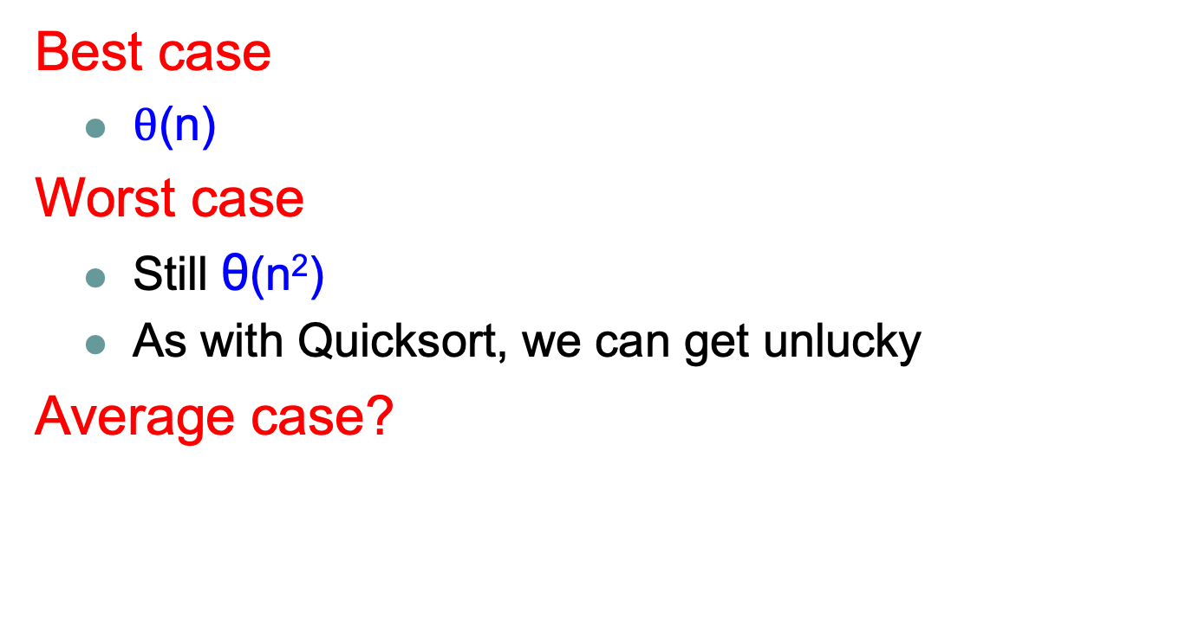
Running time of RSelection?
Best case
$θ$(n)
Worst case
Still θ(n²)
As with Quicksort, we can get unlucky
Average case?

Slide 37
Average case
Depends on how much data we throw away at each step

Slide 38
Average case
We’ll call a partition “good” if the pivot falls within within the 25th and 75th percentile
a “good” partition throws away at least a quarter of the data
Or each of the partitions contains at least 25% of the data
What is the probability of a “good” partition?
Half of the elements lie within this range and half outside, so 50% chance.

Slide 39
Average case
Recall, that like Quicksort, we can absorb the cost of a constant number of “bad” partitions

Slide 40
Average case
On average, how many times will Partition need to be called before we get a good partition?
Let E be the number of times.
Recurrence:
Half the time we get a good partition on the first try and half of the time, we must try again.

Slide 41


Mathematicians and beer
An infinite number of mathematicians walk into a bar. The first one orders a beer. The second orders half a beer. The third, a quarter of a beer. The bartender says, "You're all idiots", and pours two beers.

Slide 42
Average case
Another look. Let p be the probability of success Let X be the number of calls required

Slide 43
Average case
If on average we can get a “good” partition ever other time, what is the recurrence?
recall the pivot of a “good” partition falls in the 25th and 75th percentile

Slide 44
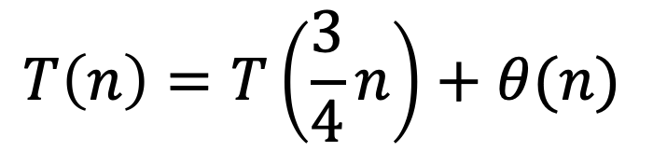
Average case
If on average we can get a “good” partition every other time, what is the recurrence?
recall the pivot of a “good” partition falls in the 25th and 75th percentile
$$T\left(n\right)=T\left(\frac{3}{4}n\right)+θ(n)$$
We throw away at least ¼ of the data
roll in the cost of the “bad” partitions

Slide 45
Which is?

Slide 46
a = b = f(n) =
1
4/3
n
Case 3: Θ(n)
Average case running time!

Slide 47
Selection
Worst case: Θ(n²)
Best case: Θ(n)
Average case: Θ(n)

Slide 48
An aside…
Notice a trend?
Θ(n)
Θ(n)

Slide 49
a = b = f(n) =
1
1/p
f(n)
0
Case 3: Θ(f(n))

Slide 50
Divide and conquer strategy
Split data in half and recurse on two halves.
Assume it works! How do we get the answer to the entire problem?
Often must do a bit of extra work.
Be careful about solutions that could span/combine the two halves.

Slide 51
Data structures
What is a data structure?
Way of storing data that facilitates particular operations.

Slide 52
Data structures
What are some of the data structures that you’ve seen?

Slide 53
Data structures review
List
Ordered Set
Priority Queue
Unordered Set
What operations do they support?
What are they good at?
How can we implement them? (Are there variations?)
What are the runtimes for the operations? (Do variations matter?)

Slide 54
Lists
get/set at index
append (add at the end of the list)
remove
add/insert

Slide 55
Ordered Set
insert
remove
contains
next/prev (successor/predecessor)

Slide 56
Priority Queue
insert
remove
min/max

Slide 57
Unordered Set
insert
remove
contains

